Slide 1
Age ≥ 16
Root of the tree
False
True
Non-leaf node with condition
Leaf node with prediction
Family Income ≥ 75,000
Y = Predicted Severity Score is 4
False
True
Parental Education Level ≥ 16
Y = Predicted Severity Score is 3

Slide 2
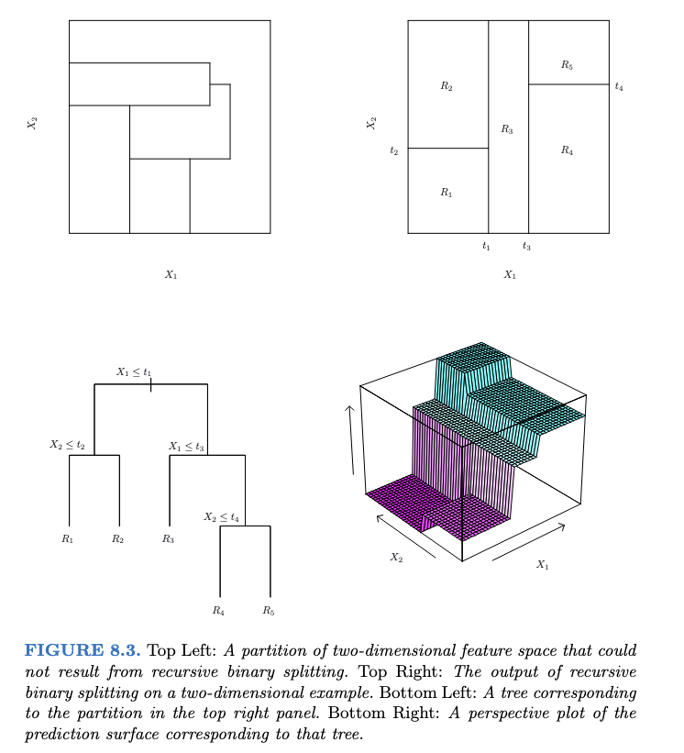
ISL

Slide 4
Single tree
+
Two summed trees
Training Error
Multiple summed trees
+ … +
Iterations

Slide 5
Achenbach System of Empirically Based Assessment
CBCL Total Problem (112-items)
Syndrome Scales
Anxious/ Depressed
Withdrawn/ Depressed
Somatic Complaints
Social Problems
Thought Problems
Attention Problems
Rule-Breaking Behavior
Aggressive Behavior
High-Level Domains
Internalizing Problems
Externalizing Problems
BPM Toal Problem (19-items)
Notes:
https://www.cambridge.org/core/journals/acta-neuropsychiatrica/article/psychometric-properties-of-the-aseba-child-behaviour-checklist-and-youth-selfreport-in-subsaharan-africa-a-systematic-review/0F7D3E2AC8CC3665EACD7E9DCBD2498B

Slide 6
Total sample (N=10730)
Excluded (n=2757) Did not have MRI scan
MRI available (n=7973)
Excluded (n=193) Images did not meet quality control criteria
Self- and parental- report available (n=7780)
Excluded (n=314) Incomplete self and/or parental report
Health (n=7466)
Excluded (n=169) Prescription medication use and (n=837) Current or present diagnosis of an unrelated psychiatric disorder
Study sample (n=6460)
Healthy control (n=6054)
OCD (n=406)
Only OCD (n=227)
Comorbid OCD (n=179)

Slide 7
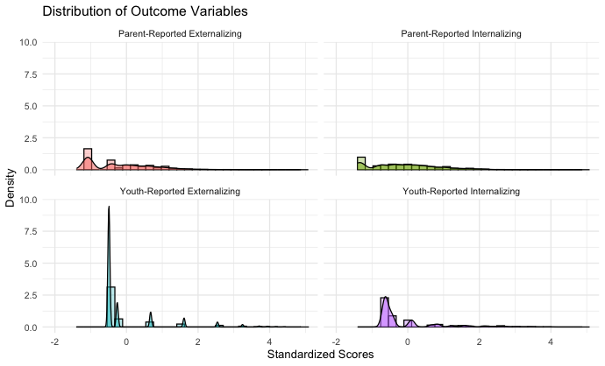

Slide 8
Bias field correction
Resample to isotripic
Gad warp correction
Processing

Slide 9
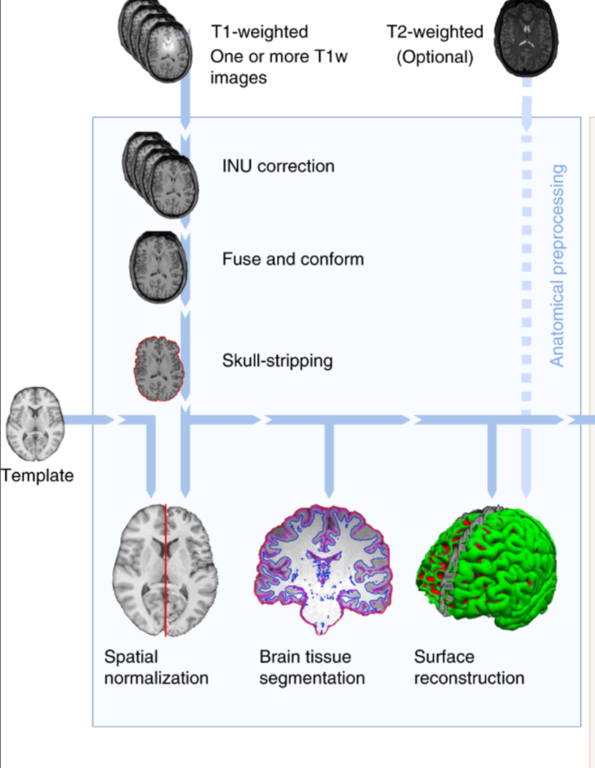
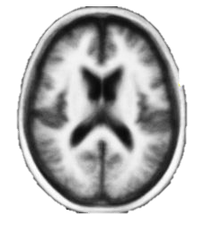

Slide 10
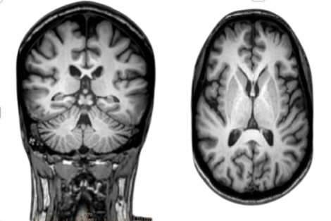
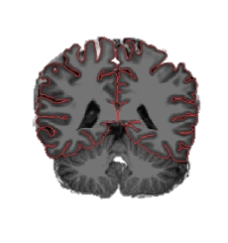
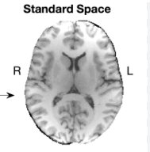
Skull stripping, volumetric labelling, intensity normalization, white matter segmentation, surface atlas registration, surface extraction, region of interest

Slide 11
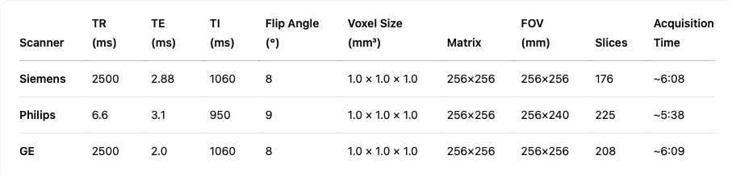
T1-weighted MRI Acquisition Summary

Slide 12
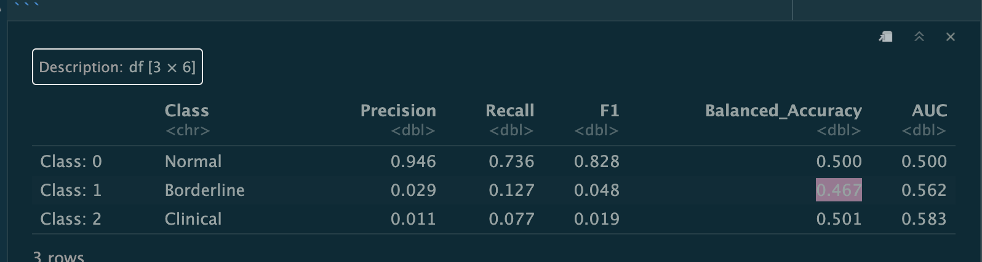
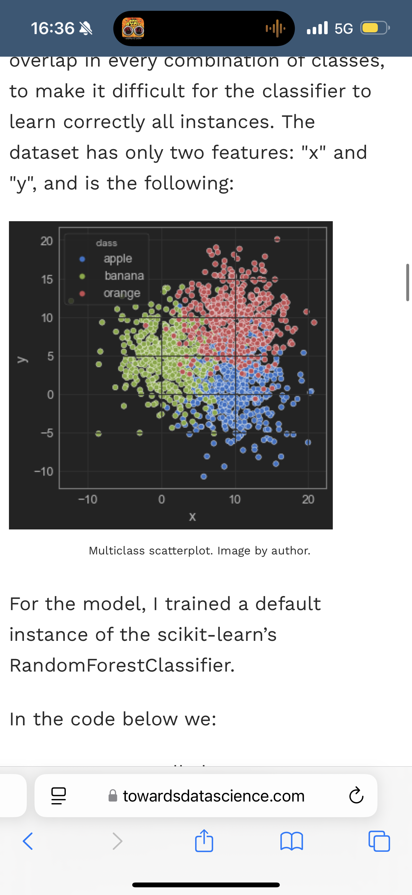
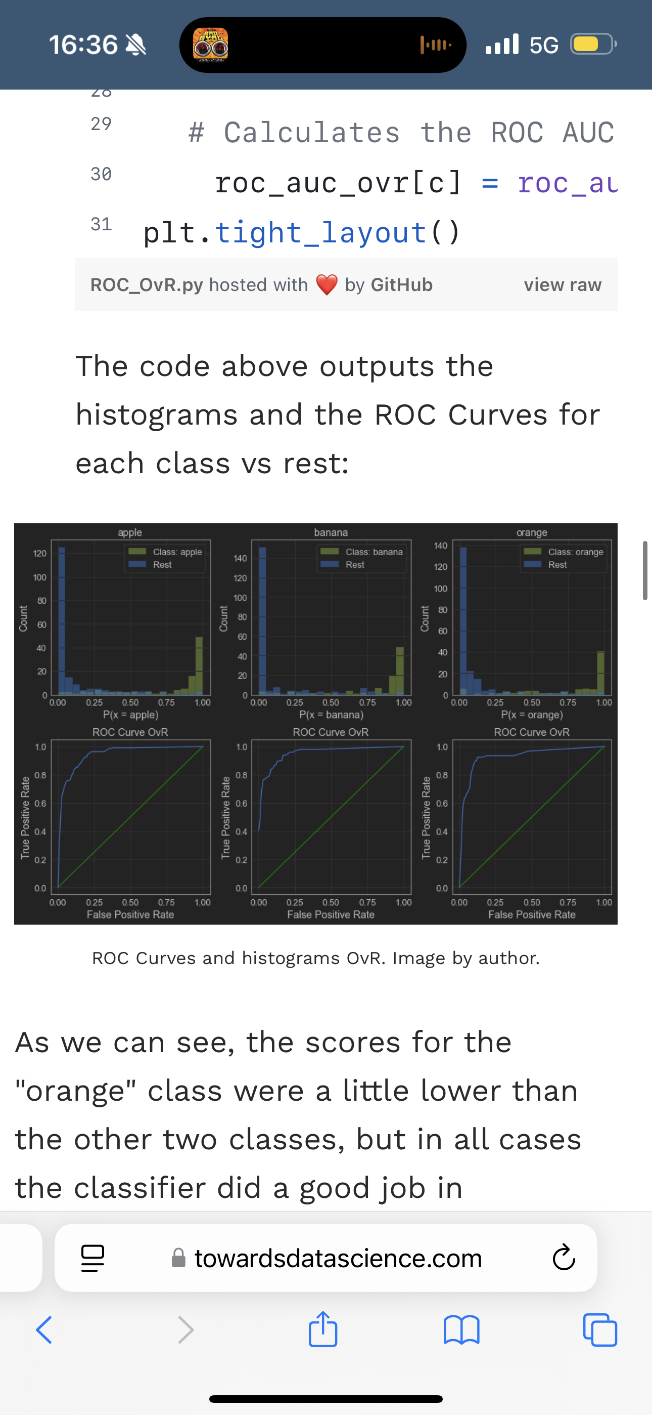

Slide 13
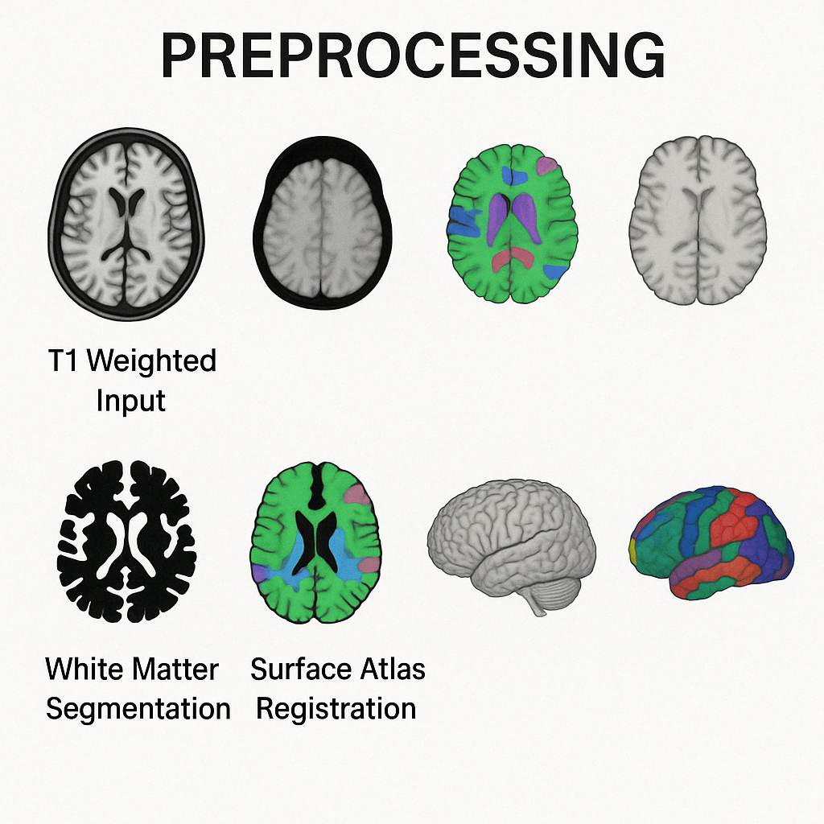

Slide 14
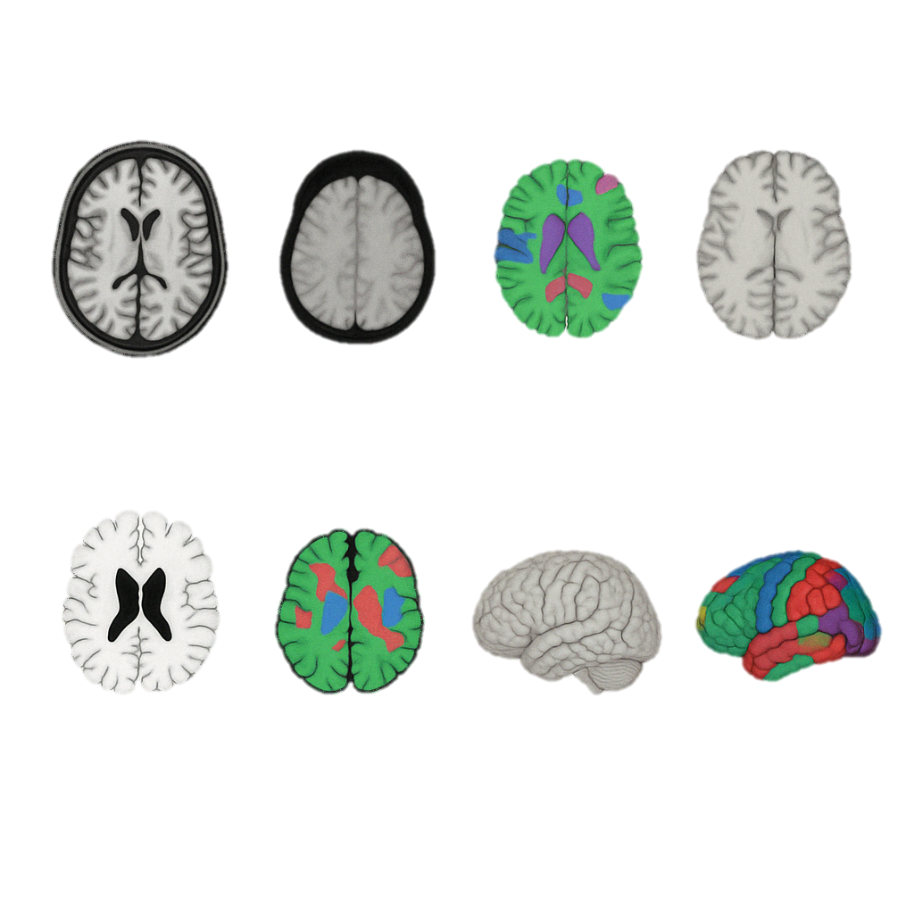

Slide 15
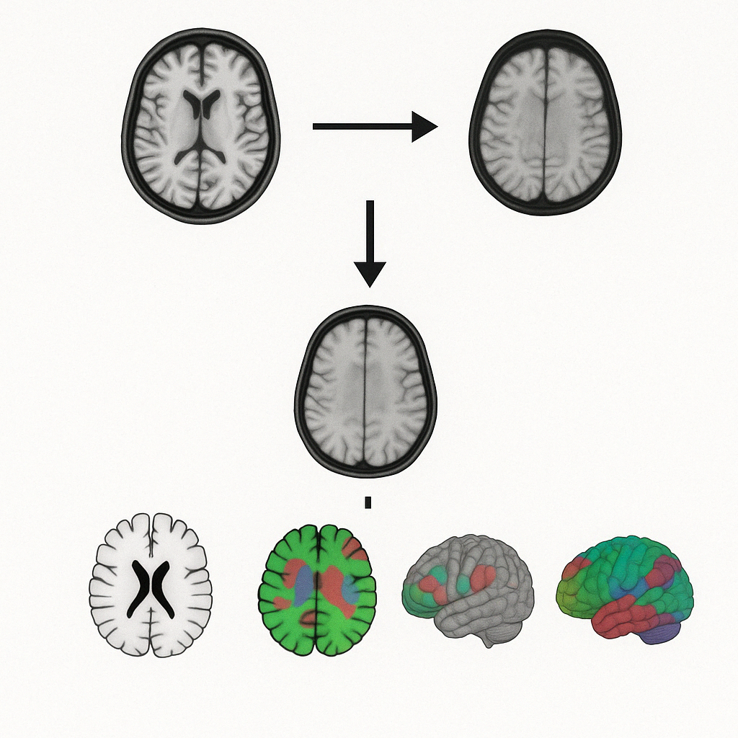

Slide 16
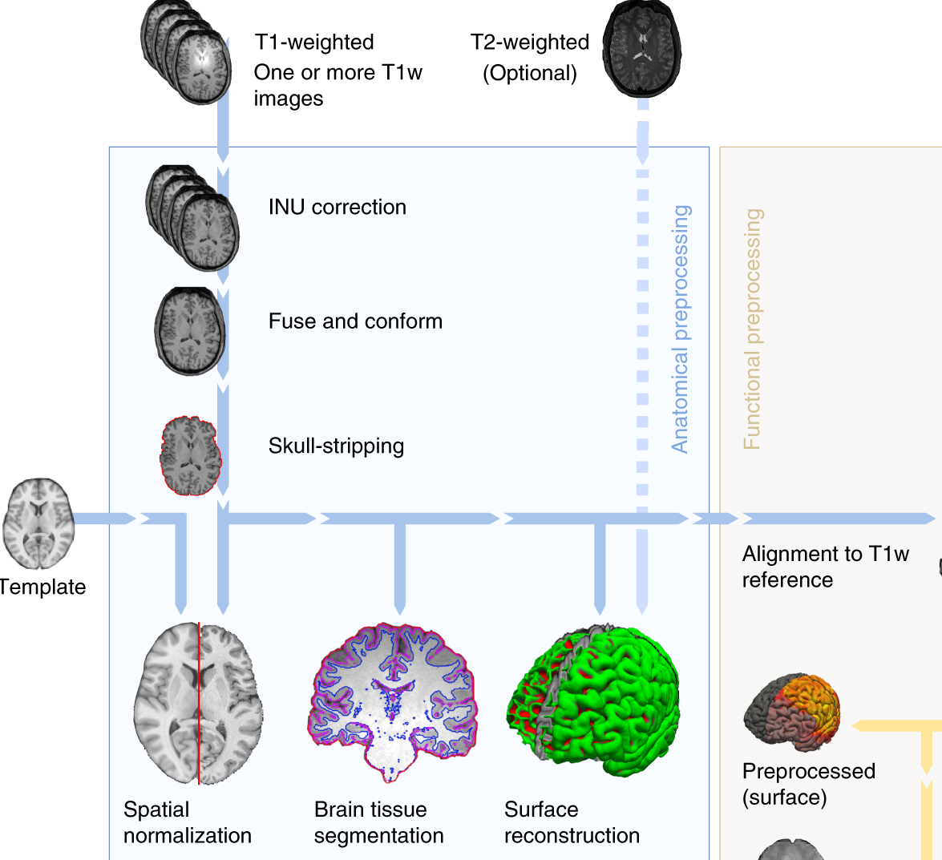
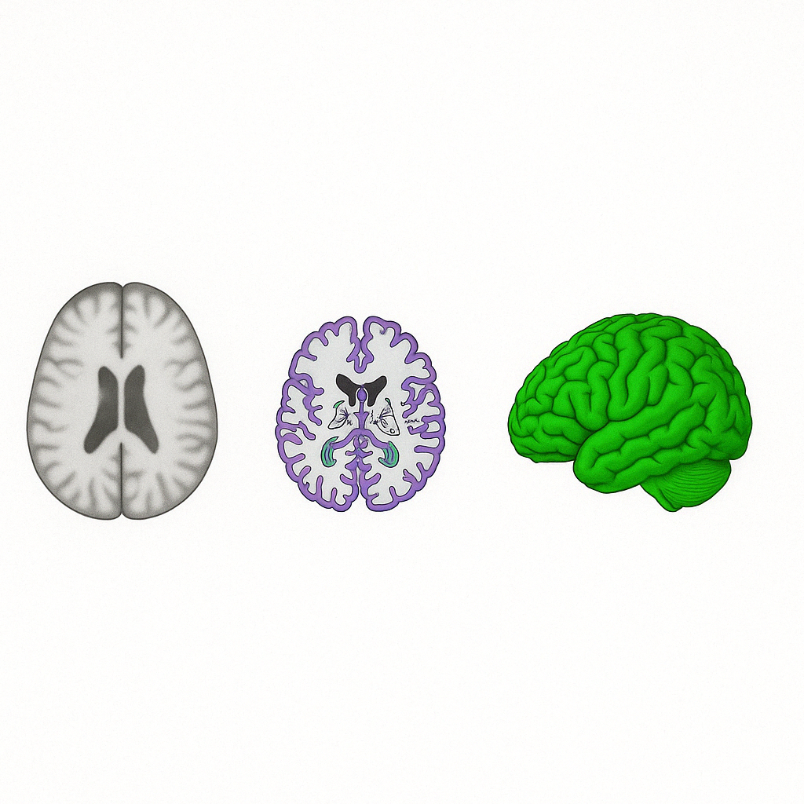

Slide 17
Sample
Hyperparameter grid search
Training Set (70%)
5-Fold Cross Validation
Model Training and Tuning
Calibration Set (15%)
Threshold Grid Search
Threshold Calibration
Test Set (15%)
Final Model
Model Evaluation

Slide 18
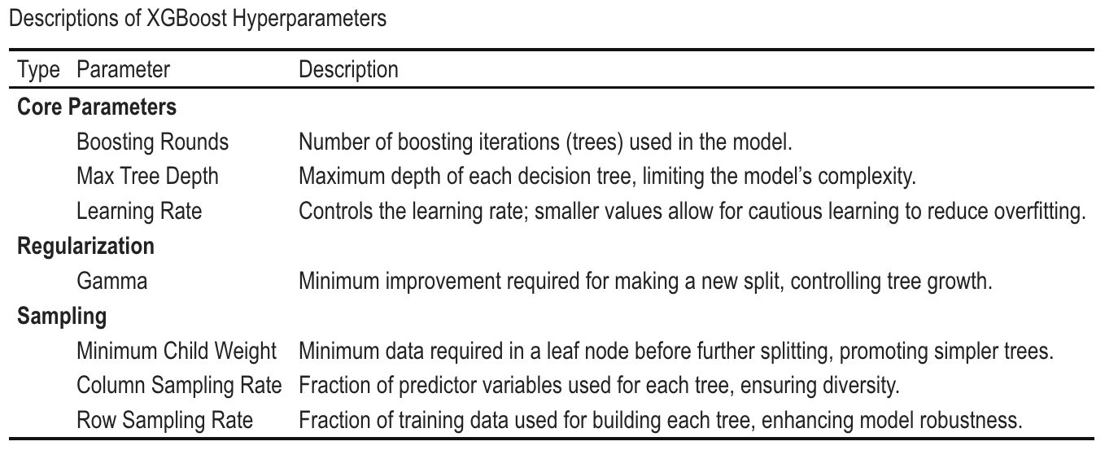

Slide 19
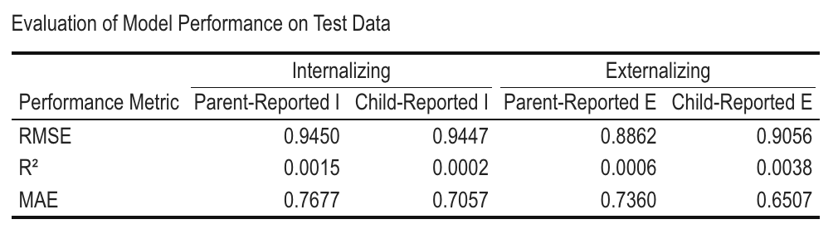

Slide 20
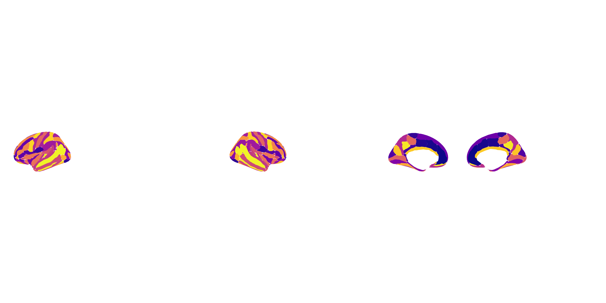
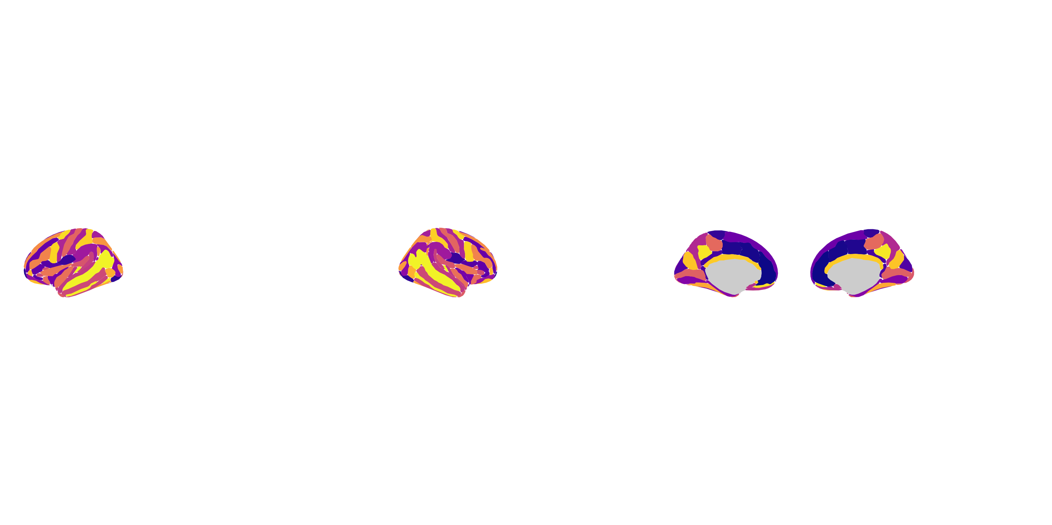
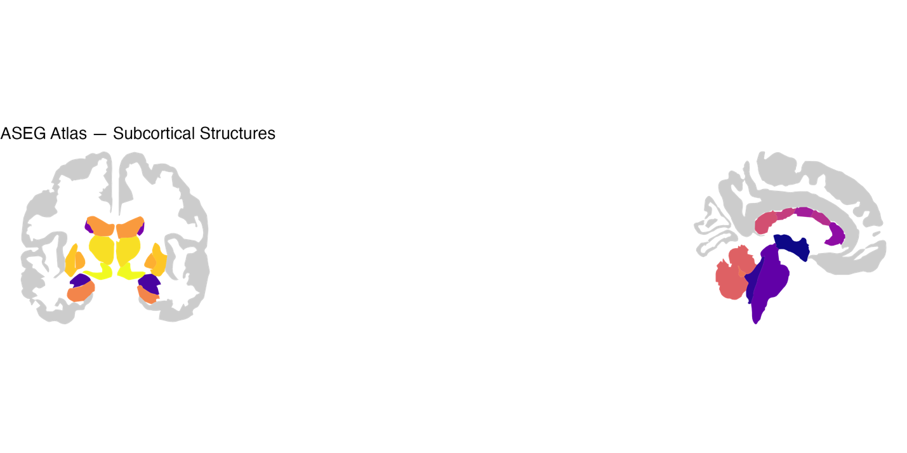
Right Hemisphere
Destrieux Atlas
Left Hemisphere
ASEG Atlas

Slide 22
 | CBCL |  |  |  | BPM
Configuration | Default | With Weights | Tuned + Argmax | Tuned + Threshold-Cal. | Default | With Weights | Tuned + Argmax | Tuned + Threshold-Cal.
Overall Performance
Accuracy | 0.3333 | 0.3323 | 0.9505 | 0.6801 | 0.3137 | 0.3158 | 0.934 | 0.9247
95% CI | 0.3037–0.364 | 0.3027–0.363 | 0.9349–0.9633 | 0.6497-0.7094 | 0.2846–0.344 | 0.2866–0.3461 | 0.9164–0.9488 | 0.9062–0.9405
Kappa | -0.0074 | 0.0224 | -0.0016 | -0.0289 | -0.0136 | -0.009 | 0.0 | -0.0168
Class Balance
Balanced Accuracy (Avg) | 0.4942 | 0.5687 | 0.4997 | 0.465 | 0.4745 | 0.4795 | 0.5 | 0.4966
Sensitivity (Borderline) | 0.28571 | 0.45238 | 0.0 | 0.048 | 0.22727 | 0.29545 | 0.0 | 0.0
Sensitivity (Clinical) | 0.41667 | 0.54167 | 0.0 | 0.083 | 0.388889 | 0.33333 | 0.0 | 0.0
Specificity (Borderline) | 0.65049 | 0.64401 | 0.99894 | 0.865 | 0.66054 | 0.66811 | 1.0 | 0.98811
Specificity (Clinical) | 0.68783 | 0.68042 | 1.0 | 0.859 | 0.657203 | 0.65089 | 1.0 | 1.0
Per-class Discrimination
Precision (Borderline) | 0.03571 | 0.05444 | 0.0 | 0.016 | 0.03086 | 0.04062 | NaN | 0.0
Precision (Clinical) | 0.03279 | 0.04127 | NaN | 0.015 | 0.021021 | 0.01775 | NaN | NaN
F1 Score (Borderline) | 0.0634 | 0.09669 | 0.0 | 0.0236 | 0.0538 | 0.07225 | 0.0 | 0.0
F1 Score (Clinical) | 0.061 | 0.07634 | 0.0 | 0.0248 | 0.0382 | 0.03344 | 0.0 | 0.0

